Slide 1
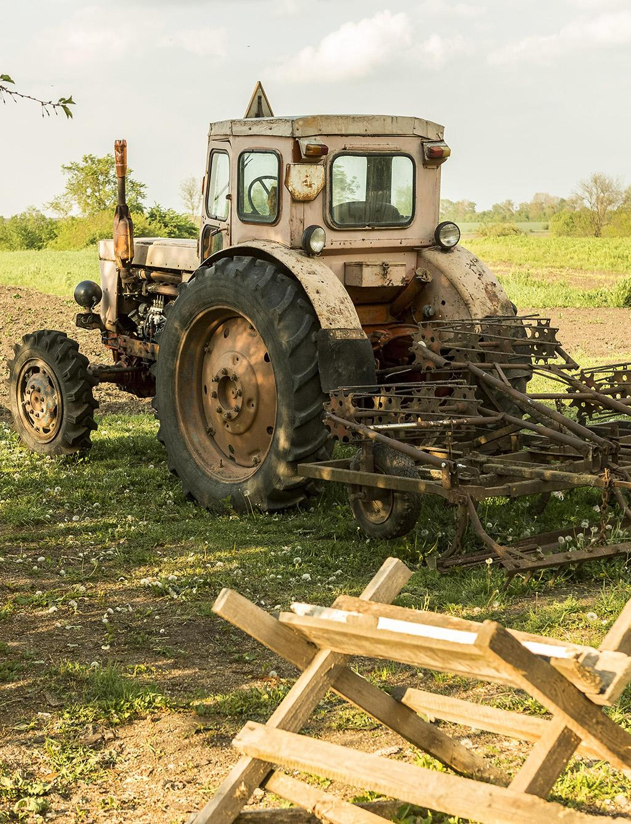
FARM-EASY
"Your Partner in Agriculture."

Slide 2
TEAM MEMBERS
Sunil Seervi
Chaitra J A
Aishwarya P

Slide 3
Overview
Introduction of Farm-Easy
Solution
Objective
Architecture
Technology Stack
Project Flow
Demo
Future Enhancements

Slide 4
Overview of Farm-Easy
Marketplace for Farmers: Enables farmers to buy, sell, or rent agricultural machinery and list their crop produce, creating a centralized marketplace.
Financial Support for Machinery: Offers specialized loan and insurance options tailored for purchasing machinery, easing the financial burden on farmers.
User Flexibility: Users are registered as buyers by default, but they can seamlessly switch to seller mode if they wish to list their products or machinery.
Awareness and Learning: Includes an awareness page featuring the latest advancements and technology videos, powered by the YouTube API, helping farmers stay informed on innovations.
Empowering Farmer Operations: By connecting farmers with resources, financial tools, and information, Farm Easy empowers farmers to grow their operations more effectively.

Slide 5
Problem Statement
Limited access to agricultural machinery due to high costs.
Difficulty in securing funds for machinery and farming needs.
Lack of awareness of modern agricultural techniques that could enhance yields.
Rent/Sell/Buy Machineries and Crops: Farmers can buy new or used equipment, rent machinery for specific needs, and sell their own equipment or produce.
Financial Support: Check eligibility for insurance and loan products, easing access to funds.
Educational Resources: Spread awareness about modern farming practices to increase productivity and yields.
Solution

Slide 6
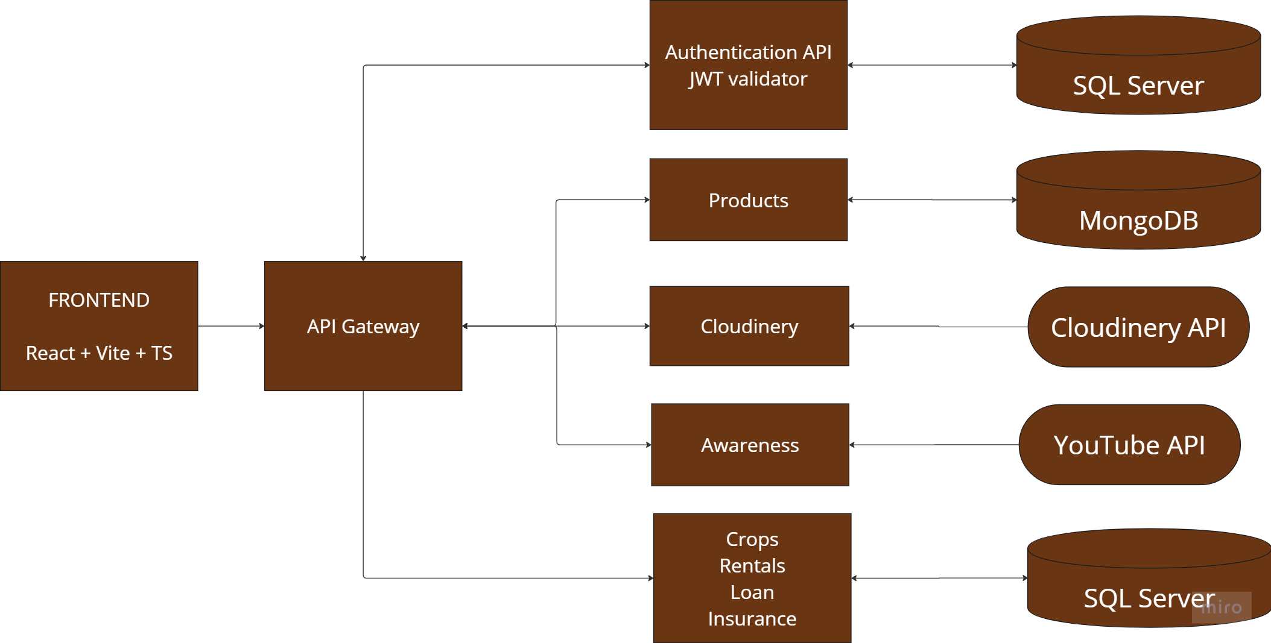
Architecture

Slide 7













Technology
Front End:
Back End:
Database:
Methodology:

Slide 8
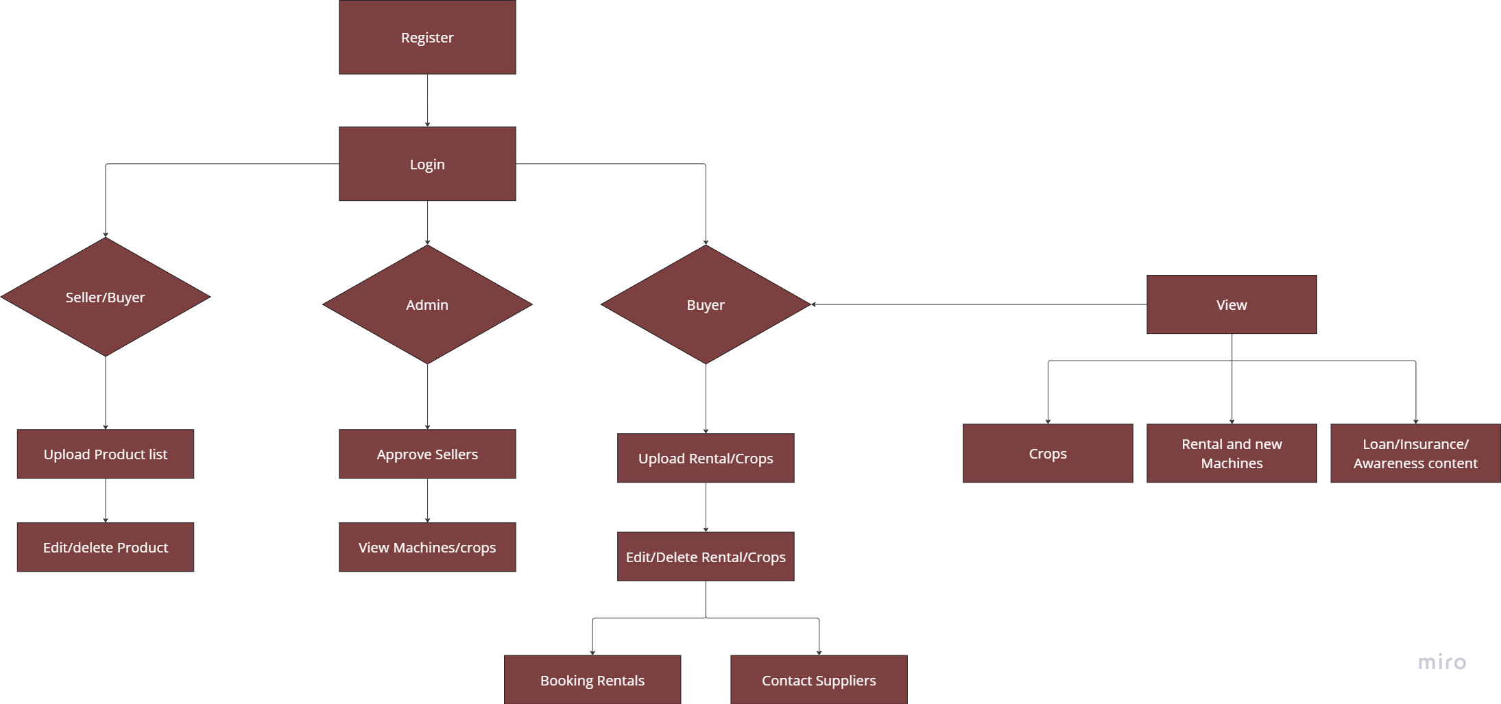
Project Flow

Slide 9
Future Scope
Ratings and Reviews
Customer support
Payment gateway

Slide 10

DEMO

Slide 11
Thanks!
Open for questions?

